Slide 1
Enagás, GRTgaz, REN and TIGF
27th IG meeting
28th March 2014

Slide 2
II.1. Results of the yearly capacity auction in March 2014
Presentation of the process development, capacity allocated

Slide 3
1. Annual Product Auction Results VIP PIRINEOS.
Bundled Capacities Offered and Allocated
Firm auctions-VIP-ES-FR Flow South-North (Spain-France)
kWh/h | 2014 | 2015 | 2016 | 2017 | 2018 | 2019 | 2020 | 2021 | 2022 | 2023 | 2024 | 2025 | 2026 | 2027 | 2028
Capacity offered | 872.772 | 872.772 | 1.068.097 | 1.068.097 | 1.068.097 | 133.029 | 133.029 | 133.029 | 133.029 | 4.932.716 | 5.511.212 | 5.511.212 | 7.373.038 | 7.373.038 | 7.373.038
Capacity Allocated | - | - | - | - | - | - | - | - | - | - | - | - | - | - | -
Firm auctions-VIP-ES-FR Flow North-South (France-Spain)
kWh/h | 2014 | 2015 | 2016 | 2017 | 2018 | 2019 | 2020 | 2021 | 2022 | 2023 | 2024 | 2025 | 2026 | 2027 | 2028
Capacity offered | 82.286 | 82.286 | 82.286 | 82.286 | 82.286 | - | - | - | - | 2.264.113 | 2.264.113 | 2.264.113 | 5.319.502 | 5.319.502 | 5.319.502
Capacity Allocated | 79.375 | - | - | - | - | - | - | - | - | - | - | - | - | - | -
Unbundled Capacities Offered and Allocated
Firm annual yearly Unbundled capacity auctions-VIP-FR-ES
kWh/h | 2014
Capacity offered | 10.431
Capacity Allocated | 10.431
Firm annual yearly Unbundled capacity auctions-VIP-ES-FR
kWh/h | 2014
Capacity offered | 2.093.348
Capacity Allocated | -
Capacities at 25º C

Slide 4
2. Allocation per Shipper.
Bundled Capacity Allocation VIP PIRINEOS
Unbundled Capacity Allocation VIP PIRINEOS
Firm annual yearly Bundled capacity Flow France-Spain
kWh/h | 2014
Capacity offered | 82.286
Shipper 1 | 41.875
Shipper 2 | 37.500
Enagas side
Firm annual yearly Unbundled capacity Flow France-Spain
kWh/h | 2014
Capacity offered | 10.431
Shipper 4 | 10.431
Auction Price
Auction Price
c€/kWh/h/year | Premium Step: 3.1
Enagas Tariff | 313,235
TIGF Tariff | 1.065,676
Final Allocation Price | 1.599,535
c€/kWh/h/year | Premium Step: 0.0
Enagas Tariff | 313,235
Final Allocation Price | 313,235
Capacities at 25º C

Slide 5
1. Annual Product Auction Results VIP IBERICO.
Flow Spain-Portugal
Flow Portugal-Spain
Firm annual yearly Bundled capacity auctions-VIP-ES-PT
kWh/h | 2014
Capacity offered | 1.535.007
Capacity Allocated | 457.500
Firm annual yearly Bundled capacity auctions-VIP-PT-ES
kWh/h | 2014
Capacity offered | 3.000.000
Capacity Allocated | -
Enagás & REN side
REN side
Firm annual yearly Unbundled capacity auctions-VIP-ES-PT
kWh/h | 2014
Capacity offered | 3.846.992
Capacity Allocated | 3.786.391
Capacities at 25º C

Slide 6
2. Allocation per Shipper.
Unbundled Capacity Allocation VIP IBERICO
Bundled Capacity Allocation VIP IBERICO
Firm annual yearly Bundled capacity Flow Spain-Portugal
kWh/h | 2014
Capacity offered | 1.535.007
Shipper 3 | 457.500
REN side
Firm annual yearly Unbundled capacity Flow Spain-Portugal
kWh/h | 2014
Capacity offered | 3.846.992
Shipper 5 | 3.490.924
Shipper 6 | 141.300
Shipper 7 | 154.167
Auction Price
Auction Price
c€/kWh/h/year | Premium Step: 0.0
Enagas Tariff | 579,227
REN Tariff | 350,90
Final Allocation Price | 930,127
c€/kWh/h/year | Premium Step: 0.0
REN Tariff | 350,90
Final Allocation Price | 350,90
Capacities at 25º C

Slide 7
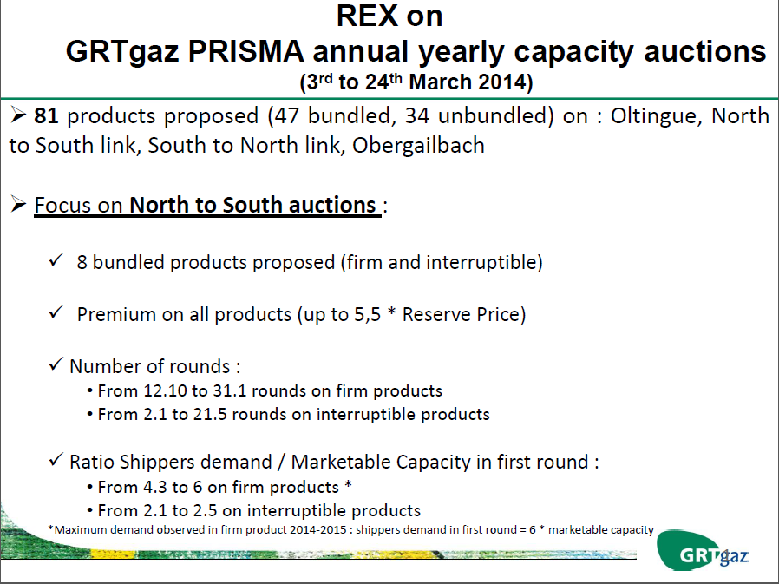

Slide 8
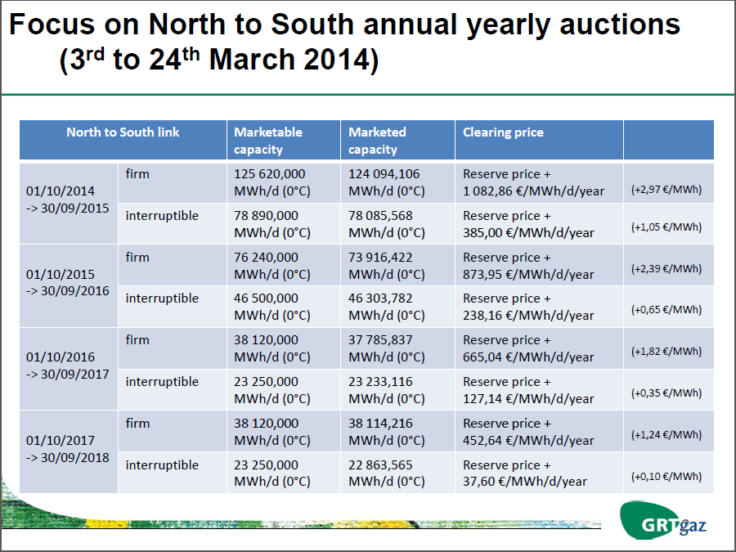

Slide 9
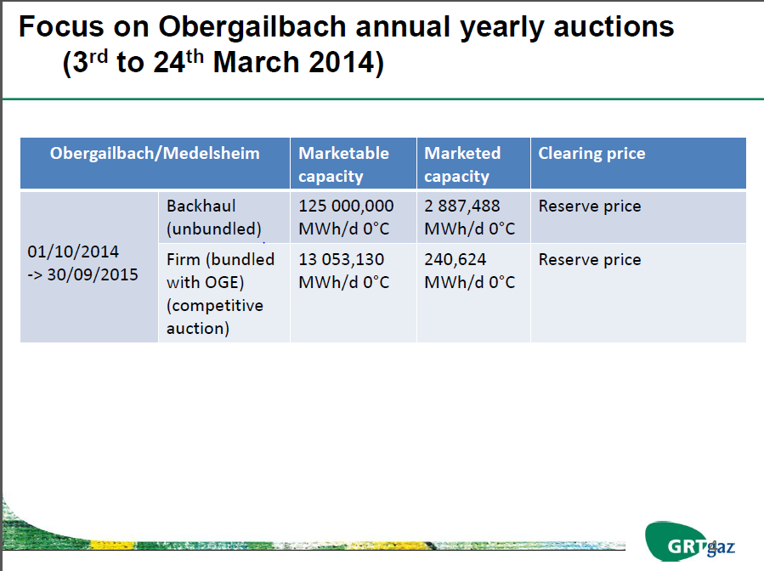

Slide 10
II.2. Quarterly capacity auction in June 2014. Preparation
Capacity to be offered in the auction

Slide 11
1. Quarterly Capacities (June Auction)
Flow South-North (Spain-France)
Firm annual quarterly Bundled capacity auction VIP-ES-FR
kWh/h | Q4 2014 | Q1 2015 | Q2 2015 | Q3 2015
10% Technical capacity | 706.496 | 706.496 | 723.119 | 723.119
Non allocated capacity | 872.772 | 872.772 | 1.022.384 | 1.022.384
Total capacity offered | 1.579.268 | 1.579.268 | 1.745.503 | 1.745.503
Capacities at 25º C
Non allocated capacity consist in capacity not allocated in the yearly product auction 2014 and capacity in IP Irún-Biriatou in summer season:
South-North: (Spain-France):
          Nov 2014 - Mar 2015 : 0 kWh/d
          Apr 2015 – Oct 2015: 10.000.000 kWh/d

Slide 12
2. Quarterly Capacities (June Auction)
Flow North-South (France-Spain)
Firm annual quarterly Bundled capacity auction VIP-ES-FR
kWh/h | Q4 2014 | Q1 2015 | Q2 2015 | Q3 2015
10% Technical capacity | 685.717 | 685.717 | 727.275 | 727.275
Non allocated capacity | 2.911 | 2.911 | 376.939 | 376.939
Total capacity offered | 688.628 | 688.628 | 1.104.214 | 1.104.214
Capacities at 25º C
Non allocated capacity consist in capacity not allocated in the yearly product auction 2014 and capacity in IP Irún-Biriatou in summer season:
North-South: (France-Spain):
          Nov 2014 – Mar 2015: 5.000.000 kWh/d
          Apr 2015 – Oct 2015: 9.000.000 kWh/d

Slide 13
3. Quarterly Capacities (June Auction)
Flow Spain-Portugal
Firm annual quarterly Bundled capacity auction VIP-ES-PT
kWh/h | Q4 2014 | Q1 2015 | Q2 2015 | Q3 2015
10% Technical capacity | 600.000 | 600.000 | 600.000 | 600.000
Non allocated capacity | 1.077.507 | 1.077.507 | 1.077.507 | 1.077.507
Total capacity offered | 1.677.507 | 1.677.507 | 1.677.507 | 1.677.507
Flow Portugal-Spain
Firm annual quarterly Bundled capacity auction VIP-ES-PT
kWh/h | Q4 2014 | Q1 2015 | Q2 2015 | Q3 2015
10% Technical capacity | 333.333 | 333.333 | 333.333 | 333.333
Non allocated capacity | 3.000.000 | 3.000.000 | 3.000.000 | 3.000.000
Total capacity offered | 3.333.333 | 3.333.333 | 3.333.333 | 3.333.333
Non allocated capacity consist in capacity not allocated in the yearly product auction 2014.
Capacities at 25º C

Slide 14
4. Quarterly Capacities (June Auction)
Flow Spain-Portugal
REN side
Firm annual quarterly Unbundled capacity auction VIP-ES-PT
kWh/h | Q4 2014 | Q1 2015 | Q2 2015 | Q3 2015
Additional available cap | 78.560 | 78.560 | 78.560 | 78.560
Total capacity offered | 78.560 | 78.560 | 78.560 | 78.560
Additional available cap consist in capacity not allocated in the yearly product auction 2014.
Capacities at 25º C

Slide 15
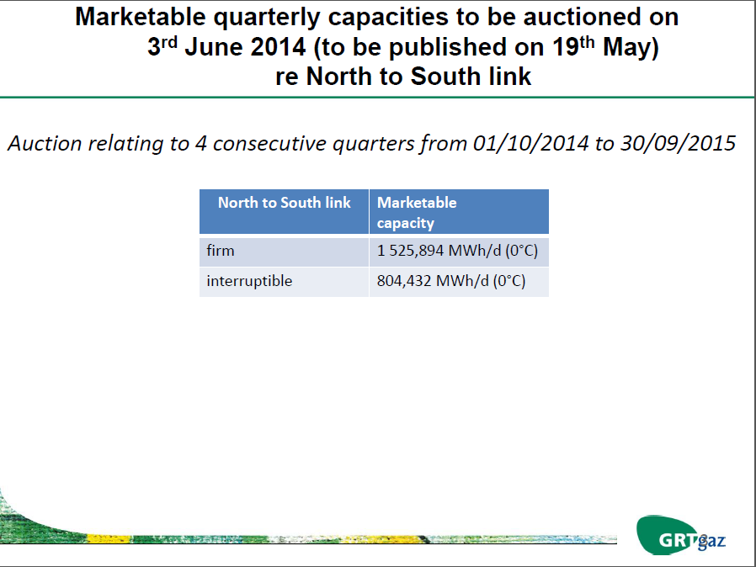

Slide 16
II.2. Quarterly capacity auction in June 2014. Preparation
Potential offer of interruptible capacity. Rules and conditions for offering interruptible capacity in the three countries

Slide 17
1. Conditions to offer interruptible capacity
Enagas and REN have already agreed the following principles:
No interruptible capacity will be offered on gas year 2014-2015 yearly, quarterly or monthly capacity auctions.
Day-ahead interruptible capacity shall only be offered if 98% of the equivalent firm technical capacity has been previously allocated.
For the upcoming gas years, interruptible capacity, if available, shall also only be offered if 98% of the equivalent firm technical capacity has been previously allocated.
In any case, interruptible capacity products will be sold in accordance with the NRA’s decision regarding possible bundling of products in the Portuguese-Spanish border.

Slide 18
2. Conditions to offer interruptible capacity
Enagas and TIGF have already agreed the following principles:
If there are interruptible products on both sides of the border, they will be offered in an unbundled way as the conditions for interruption in principle are different on both sides of the IP.
Once the auction for the corresponding firm bundled and unbundled product has finished, each TSO will decide whether to offer the corresponding interruptible product in the second slot. Interruptible capacity will be offered through daily products, and could be as well offered through quarterly and monthly products from 2014, based on each TSO’s decision (interruptible products will be offered as unbundled products). On the Spanish side only, interruptible capacity could be offered as well through yearly products (only for the year N+1).
The default rule, unless otherwise stated, will be that interruptible products will only be offered if 98% of the corresponding firm technical capacities have previously been allocated.

Slide 19
3. Next steps
During the gas year 2014:
  Only day-ahead interruptible products will be offered in 98% of the firm technical capacity has previously been allocated.
  Interruptible capacity will be offered in an unbundled way
For the gas year 2015:
  TSOs will further discuss how interruptible products will be offered.
  As a general rule:
    TSOs shall offer daily capacity products for interruptible capacity in both directions at IPs where firm capacity has been offered but was sold out day-ahead.
    TSOs may offer interruptible products for longer duration.
    If interruptible capacity is offer, this shall not be detrimental to the amount of firm capacity offer.

Slide 20
IV. Update of the development of GRIP / TYNDP

Slide 21

South Region
Second Edition
Gas Regional Investment Plan
27th IG – 28 March 2014

Slide 22
Table of content
  Perimeter / objectives
  Content
  Planning
22

Slide 23
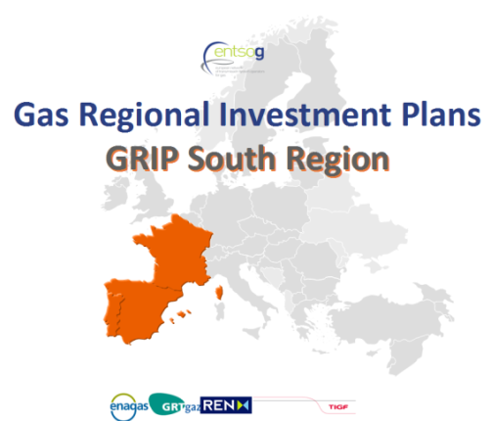

Perimeter /Objectives
3 Countries (FR, SP, PT) and 4 TSOs
Main drivers/objectives
Complementing the EU-TYNDP 2013
Feedbacks received:
  updated information / TYNDP
  More harmonization (with ENTSOG assistance)
  More communication/consultation
  More comprehensive approach on the system needs and on remedies (projects)
EU energy policy, “Trans-European energy infrastructure” (17/04/13)
“The strategic concept of the North-South Corridor in Western Europe, that is to better interconnect the Mediterranean area and thus supplies from Africa and the Northern supply Corridor with supplies from Norway and Russia.” (EC, EIP for 2020)

Slide 24
GRIP South – Demand
ANALYSES (2012) & FORECASTS
Weight/size of the South Region:
18% of EU gas demand
Focus on the Power generation sector:
Lost of competitiveness / coal
Differences / countries

Slide 25
GRIP South – Demand
ANALYSES (2012) & FORECASTS
Demand forecasts:
Updated: yearly volumes, peak days and cold period
Analyzed:
  By sectors (power gen.)
  Evolution / TYNDP

Slide 26
GRIP South – Supply
Imports (99%)
reliant on LNG (14% at EU level)
Very diversified portfolio but not homogeneous by countries
Market spreads within the region (World LNG prices …)
Additional Gas Supply (EU)
Non conventional gas →EU?
Biogas → LT
LNG
Local (by pipe) conventional reserves
Infrastructures: “EU Priority corridors”
North-South Corridor to better interconnect Portugal, Spain and supplies from Algeria to the Northern supply Corridor with supplies from Norway and Russia.

Slide 27
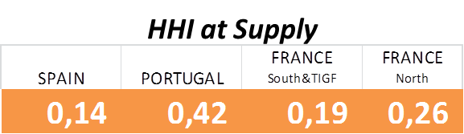
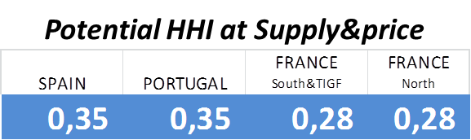
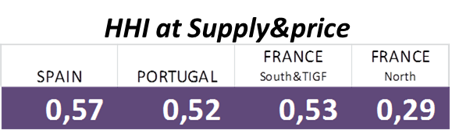
GRIP South – Assessments
Key conclusions
Resilience assessment:
Sufficient capacity for a complete supply/demand balance
Key role of UGS and LGN for short term flexibility and security of supply
The lack of resilience to low LNG deliverability detected in the TYNDP for the Iberian Peninsula is not the facto a risk of security of supply for Spain (high level of LNG diversification by country origin)
Portugal could also improve this issue promoting the LNG diversification.
Supply Source Dependence
High dependence on LNG in the South of France and Iberian Peninsula causes strong price peaks, but not security of supply risk
*
*
Potential evolution after developing the new corridor “Bidirectional flows between Portugal, Spain, France and Germany”
* grouping the supply sources by correlated prices

Slide 28
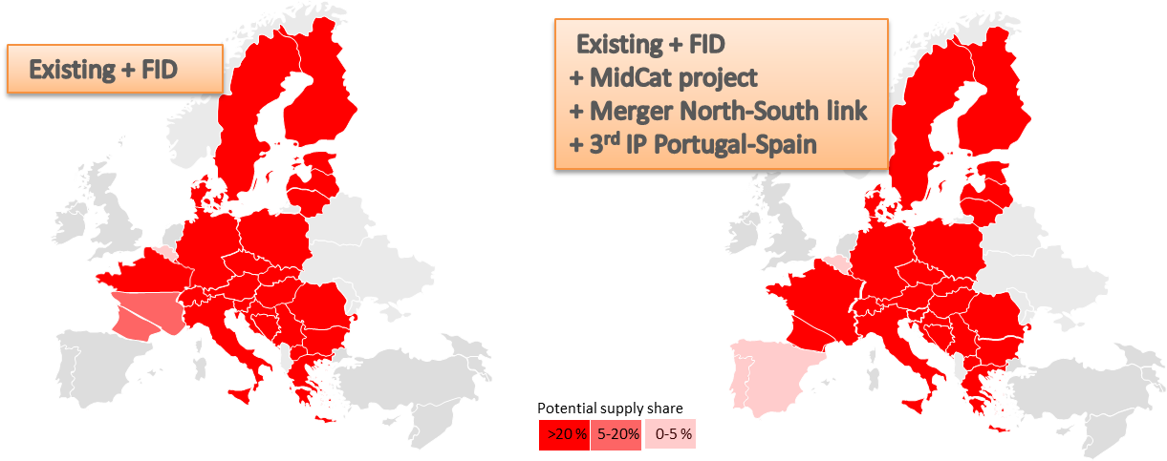
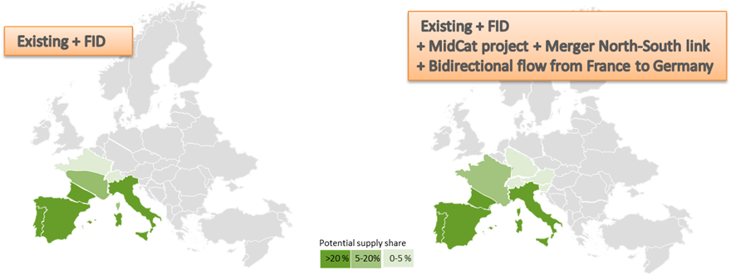
GRIP South – Assessments
Key conclusions
Network adaptability to supply evolution
Identified remedies would create new routes to and from the South, contributing to the optimization of shippers’ supply portfolios, consolidating a well-meshed network, improving the robustness of the gas network.
The identified remedies would improve competitiveness for the industry and the rest of the end consumers of the gas system having a clear positive impact in the economy of the respective countries.

Slide 29
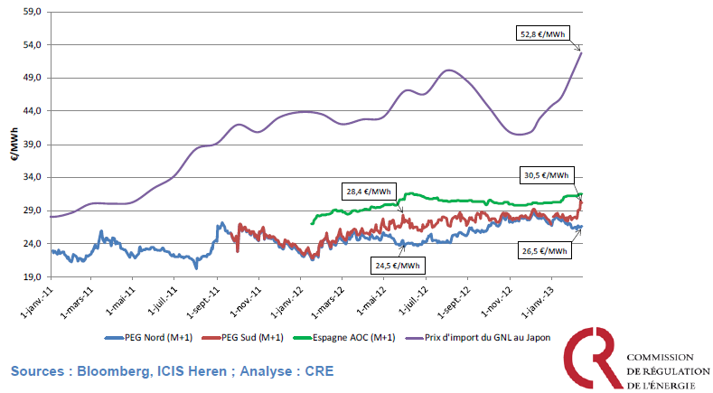
GRIP South – Assessments
Key conclusions
Strong divergences of prices :
Lasting spreads between PEG SUD and Spanish AOC, between PEG NORD and PEG SUD
Lack of ability to face very different supply mixes,
In particular, limited ability to decrease LNG supplies

Slide 30
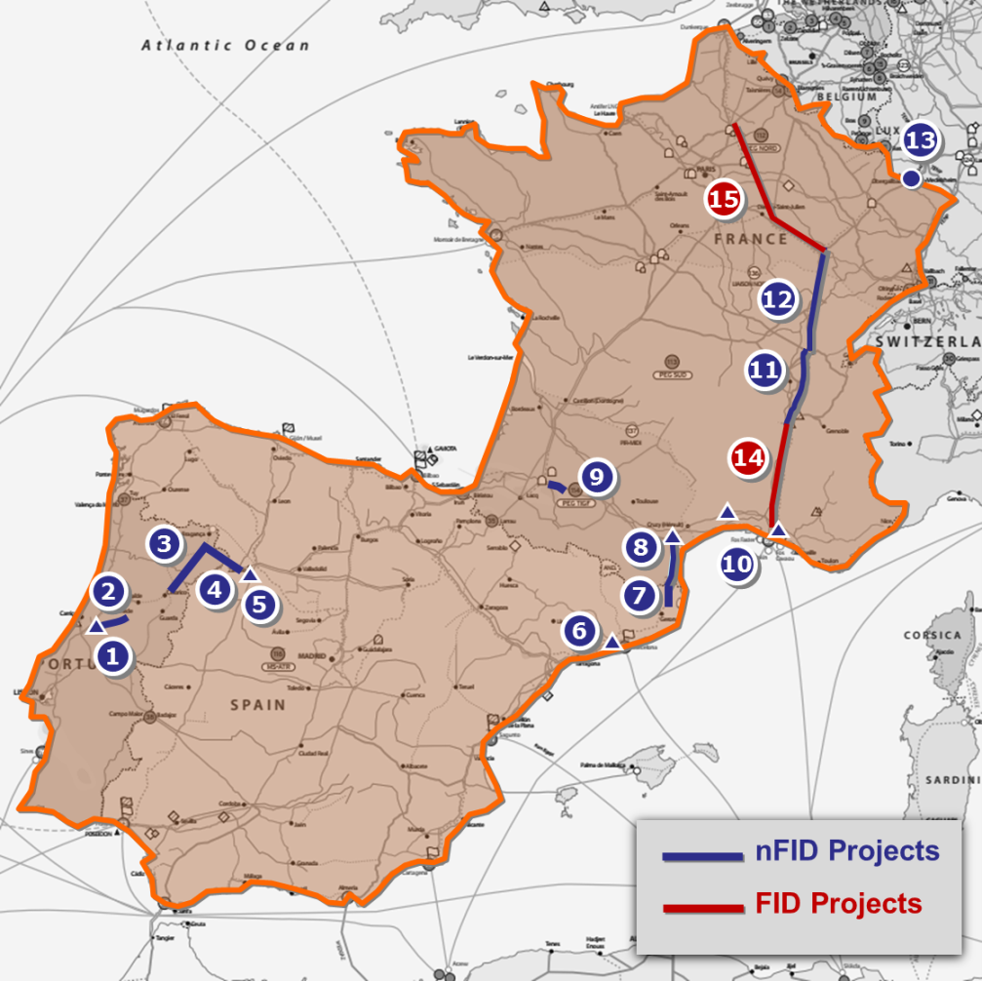
GRIP South – Assessments
Key conclusions
Remedies to divergence of prices
Reduce LNG dependence with bi-directionnal flows between Portugal, Spain, France and Germany with:
3rd IP between Portugal and Spain
MidCat project
Core network reinforcement in France (merger)
Reverse flow from France to Germany

Slide 31
Main conclusions
Economic crisis and competition of energies in the World lead to a decrease in gas consumption in Europe.
As forecasts for gas imports for Europe remain high, South Region could be a main for Algerian gas and LNG. High dependence on LNG should be reduced if more Russian and Norwegian gas could reach southern markets.
A lot of transmission, LGN and storages projects identified. Some of them FID, that will increase interconnection capacities within South Region and with the rest of Europe,
Assessment & remedies: existing system and FID projects not sufficient to face different supply mixes and to create price convergence. The corridor “Bidirectionnal flows between Portugal, Spain, France and Germany” is one of the identified remedy to these issues.
Investments needed are significant. Clear energy policies and support from authorities will be needed in order to secure the cost effectiveness of these investments for the market.

Slide 32
Planning
  ENTSOG TYNDP publication : 21st February 2013
  Communication / consultation
    Continuous and extensive consultation for identifying and updating projects and needs
    GRI South meeting(s): IG & SG meetings (6)
    Public consultation from December 12th to January 5th
    Regulators: “Draft GRIP” shared on December 20^{th,} opinion received on January 31st
    Feedbacks after publication
  Publication & consultation: March 27th
    Simulations updating demand and projects using NeMo tool remain in line with TYNDP 2013
    GRIP finalized with latest feedbacks from NRAs and data updates
    Published in ENTSOG and in TSOs websites 27th March 2014
    Public consultation open until 1st May 2014
32

Slide 33
Thank you for your attention

Slide 34
Thank you for your attention!

